Slide 1


LINUX os
Bat el peretz
Introduction to linux operating system

Slide 2
Session overview
LINUX OS
What is Linux?
Why should we learn linux as devops?
The linux ecosystem + History
Linux distributions
Getting started With linux command line
Using Linux help resources
Linux basic commands
Demonstration + Exercise
Conclusion + Q & A

Slide 3
LINUX OS
WHAT IS LINUX?
Linux is a type of operating system, just like Windows or macOS. It's designed to work on a wide range of devices, including computers, servers, and even some smartphones.
One of the main things that sets Linux apart from other operating systems is that it's open source. This means that the code that makes up Linux is freely available for anyone to use, modify, and distribute.
Linux is also known for its security and stability, which makes it a popular choice for servers and other mission-critical systems.
Overall, Linux is a powerful and versatile operating system that's used by millions of people around the world.

Slide 4
Why should we learn linux as devops?
LINUX OS
Linux is the most widely used operating system in the DevOps world: Many of the tools and technologies used in DevOps are built for Linux, including Docker, Kubernetes, Ansible, Puppet, and Jenkins.
Linux is highly customizable: Linux can be configured to work in almost any environment and can be customized to meet the needs of specific applications or systems.
Linux is cost-effective: Linux is a free, open source operating system, which makes it a cost-effective option for many organizations.
Linux is highly scalable: Linux is designed to be highly scalable, which makes it a great option for DevOps teams working with large, complex systems.

Slide 5

The linux ecosystem
LINUX OS
The original Linux kernel was created by Linus Torvalds in 1991,
And then donated to the community -> Anyone! Anywhere! Anytime!
The programming code of Linux will be freely for everybody to download, modify, and just do anything they want with it.

Slide 6
Linux distributions
LINUX OS
Because Linux is an open source, a lot of individuals & groups in the larger community, created their own version of the OS.
Android - (mobile devices)
Red-Hat Enterprise Linux (CentOS)
Scientific Linux (Math and science)
Kali Linux (Security)
Ubuntu- all round
Mint (Customer friendly)

Slide 7

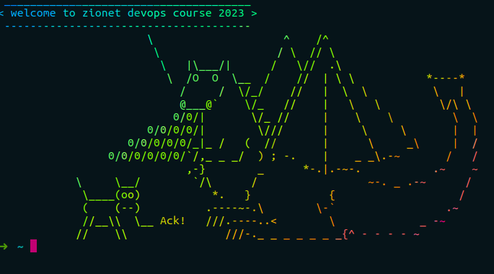
Started
With linux command line
LINUX OS
GETTING

Slide 8
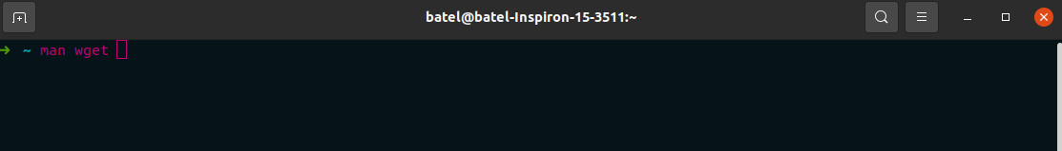
USING LINUX HELP RESOURCES
LINUX OS
There are hundreds of linux core commands, and remembering all the commands can be tricky. There’s always the option of searching the Internet.
But Linux has its own built-in support systems!
Most programs come with their own manual files as part of the man system.

Slide 9

SUDO
LINUX OS
sudo is a command in Linux that allows a user to execute commands with the privileges of the root user. The term "sudo" stands for "superuser do".
However, there may be times when a user needs to execute a command with root privileges in order to perform a task that requires elevated permissions, such as installing software or modifying system files. This is where sudo comes in.

Slide 10
Linux basic commands
LINUX OS
ls - list files and directories
cd - change directory
mkdir - make a new directory
echo - print a message to the terminal
rm - remove files or directories
pwd - print the current working directory
cp - copy files or directories
mv - move or rename files or directory
cat - print the contents of a file to the terminal
history - show a list of previously executed commands
touch - create an empty file or update the timestamp of an existing file
man - display the manual page for a command
apt-get install - install a package or program and its dependencies.

Slide 11
Linux basic commands - exercise!
LINUX OS
Create a directory called "devops-exercise" using the mkdir command.
Navigate into the "devops-exercise" directory using the cd command.
Use the touch command to create three empty files called "file1.txt", "file2.txt", and "file3.txt".
Use the echo command to write a message to each file. For example, you can write "Hello, World!" to "file1.txt", "This is file 2" to "file2.txt", and "Testing 123" to "file3.txt".
Use the ls command to confirm that the files were created and that they contain the expected messages.
Use the cp command to make a copy of "file1.txt" called "file1_copy.txt".
Use the mv command to rename "file2.txt" to "renamed.txt".
Use the cat command to print the contents of "file3.txt" to the terminal.
Use the rm command to delete "file3.txt".
Use the history command to show a list of the previously executed commands.
Use the man command to display the manual page for the ls command.

Slide 12

LINUX OS
WORKSHOP TIME!
Let’s try the linux command line

Slide 13

Exercise:
LINUX OS
Create new directory - (mkdir) for the course.
Navigate to that directory
Download Cowsay package management
Download lolcat package management
Print to the screen A short sentence + your name. Use the flag (-f) and choose cartoon you liked.
Don’t choose the unipony from the example!
You can choose whether to make it colorful or not.
Share it with the class!

Slide 14

LINUX OS
BASH BASIC COMMANDs QUIZ!

Slide 15

LINUX OS
Permissions and Users in Linux

Slide 16
Permissions and users -> Introduction
LINUX OS
Linux is a multi-user operating system, which means that multiple users can access and use the system simultaneously. Each user has their own account, which is protected by a password.
Permissions in Linux refer to the access rights that are granted to a user or group of users for a particular file or directory.
These access rights determine whether a user can read, write, or execute a file or directory.
Understanding permissions and users is important for working with Linux systems, as it allows users to control who can access their files and directories and what actions they can perform on them.

Slide 17
USERS
LINUX OS
In Linux, users are identified by their username and user ID (UID).
Each user has their own home directory, which is where they can store their personal files.
To create a new user, you can use the "useradd" command followed by the username. For example, to create a new user named "batel", you can run the command "sudo useradd batel".
To set password - “sudo passwd batel”.
To switch to a different user, you can use the "su" command followed by the username. For example, to switch to the user "batel", you can run the command "su batel".
The superuser, or root user, has full administrative access to the system and can perform any action. It is important to use caution when using the root account.

Slide 18

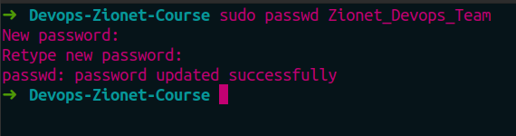
USERS - examples
LINUX OS
Create a new user - for example: "sudo useradd Zionet_Devops_Team".
To set password use: “sudo passwd Zionet_Devops_Team” :

Slide 19
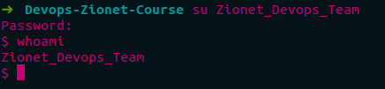
USERS - examples #2
LINUX OS
To switch to a different user, you can use the "su" + Username. For example, "su Zionet_Devops_Team".
You can check the username of the current account by running the whoami command.
And you can also check the current working directory with the pwd command.

Slide 20
Permissions
LINUX OS
Permissions in Linux are represented by a series of letters and symbols that indicate who has access to a file or directory and what actions they can perform. For example, the permission string "rwxr-xr--" means that the owner of the file has read, write, and execute permissions, while the group and other users only have read and execute permissions.
The three types of permissions are:
Read: Allows a user to view the contents of a file or directory
Write: Allows a user to modify the contents of a file or directory
Execute: Allows a user to run a file or access the contents of a directory

Slide 21
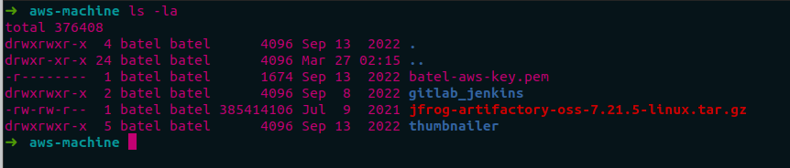
Permissions #2
LINUX OS
To view the permissions for a file or directory, you can use the "ls -la" command. This will display a list of files and directories along with their permissions, ownership, and modification dates.

Slide 22
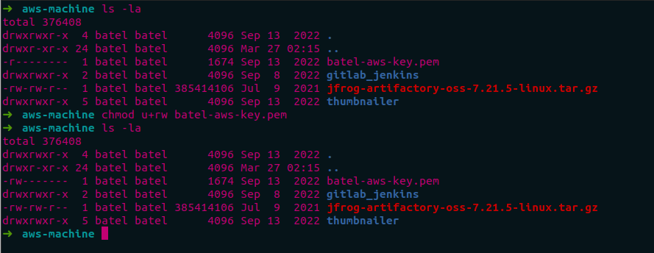
Permissions #3
LINUX OS
To change the permissions of a file or directory, you can use the "chmod" command followed by the desired permission settings. For example, to give the owner of a file read and write permissions, you can run the command "chmod u+rw file.txt".

Slide 23
Permissions #4
LINUX OS
Numeric permissions are represented by a three-digit number, where each digit represents a specific permission. The first digit represents the permissions for the owner of the file, the second digit represents the permissions for the group owner of the file, and the third digit represents the permissions for all other users. Each digit can be a combination of the following values:
4: read permission
2: write permission
1: execute permission
For example, if the numeric permissions for a file are 644, it means that the owner of the file has read and write permissions (4+2=6), and the group owner and all other users have only read permissions (4).
On the other hand, regular permissions (or symbolic permissions) are represented by a combination of letters, symbols, and operators. The most common symbols used in regular permissions are:
r: read permission
w: write permission
x: execute permission
-: no permission

Slide 24
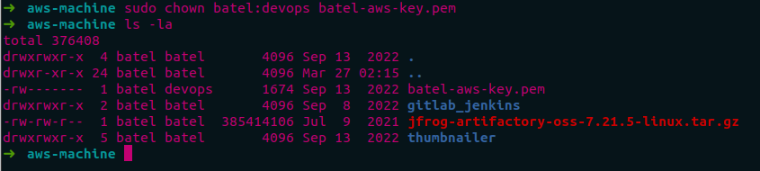
Permissions #5
LINUX OS
Ownership in Linux refers to the user and group that own a particular file or directory. To change ownership, you can use the "chown" command followed by the new user and group. For example, to change the ownership of a file to the user "batel" and the group "staff", you can run the command "sudo chown batel:staff file.txt".

Slide 25
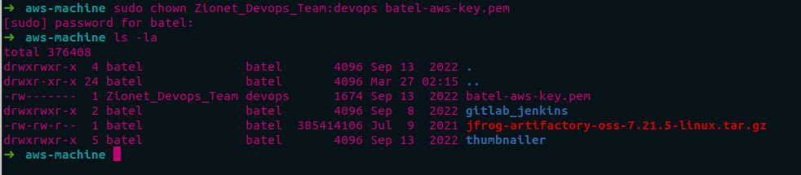
Permissions #6
LINUX OS
Ownership in Linux refers to the user and group that own a particular file or directory. To change ownership, you can use the "chown" command followed by the new user and group. For example, to change the ownership of a file to the user "Zionet_Devops_Team" and the group "devops", you can run the command "sudo chown Zionet_Devops_Team:devops file.txt".

Slide 26

Users & permissions exercise
LINUX OS
Link to the exercise:
Users and permissions exercise
Be sure to send a screenshot at the end!

Slide 27

LINUX OS
VIM EDITOR

Slide 28
INTRODUCTION
LINUX OS
We'll be learning about a powerful text editor called Vim that's built into most Linux systems.
Vim is useful for editing configuration files, scripts, and other text-based files.
Why Use Vim?
Vim has a steep learning curve, but it's worth the effort to learn.
Once you get the hang of it, Vim can make you much more productive when working with text-based files.
Vim is a command-line tool, which can be more efficient than using a graphical user interface.
Vim has three different modes: normal, insert, and visual.
Normal mode is used for navigating and manipulating text.
Insert mode is used for entering and editing text.
Visual mode is used for selecting and manipulating text.

Slide 29
Basic Commands in Normal Mode
LINUX OS
To enter insert mode, press "i".
To save changes and exit Vim, type ":wq" (write and quit).
To exit Vim without saving changes, type ":q!" (quit without saving).
To move the cursor, use the arrow keys or "h", "j", "k", and "l".
To search for text, type "/searchterm".

Slide 30
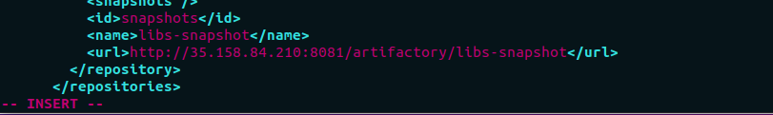

Basic Commands in insert Mode
LINUX OS
In insert mode, you can type text as you would in any other text editor.
To exit insert mode and return to normal mode, press "Esc".

Slide 31
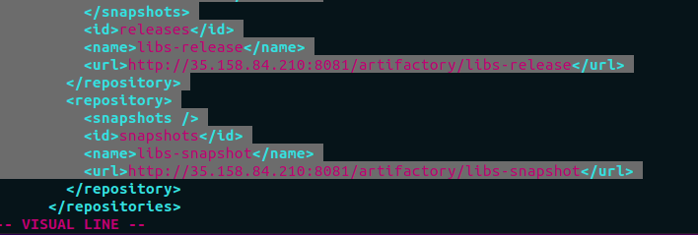
Basic Commands in visual Mode
LINUX OS
In visual mode, you can select text by moving the cursor.
To enter visual mode, press "v".
To select a block of text, move the cursor to the start of the block, press "V", move to the end of the block, and then press "y" to copy or "d" to delete.

Slide 32
SHELL SCRIPTING introduction
LINUX OS
Shell scripting is a fundamental skill for DevOps engineers, as they often need to write scripts to automate deployment, testing, and monitoring tasks.
Shell scripts are essentially a set of commands that are executed in a specific order. They can be used to automate all sorts of tasks, from backing up files to analyzing logs to deploying applications. By writing shell scripts, DevOps engineers can save time and ensure that tasks are performed consistently and reliably.
For example, let's say you need to backup your database every day. Instead of manually running the backup command every day, you can write a shell script to automate the process. This will save you time and reduce the risk of errors.
Another example is deploying an application to a server. This can be a complex process involving multiple steps, such as copying files, updating configurations, and restarting services. By writing a shell script, you can automate this process and ensure that the application is deployed consistently across different environments.
Now, it's important to note that shell scripting can be done with any text editor, but we'll be using Vim for this course.

Slide 33

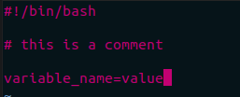
SHELL SCRIPTING - BASIC CONCEPTS
LINUX OS
Shebang line:
The first line of a shell script is known as the shebang line, which tells the system what interpreter to use to execute the script : #!/bin/bash
Comments:
Comments start with the # symbol
Variables
Variables are used to store values that can be used throughout the script. You can set a variable using the syntax:

Slide 34
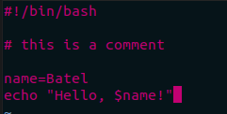
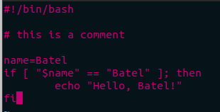
SHELL SCRIPTING - BASIC CONCEPTS #2
LINUX OS
Variables example:
Conditionals and loops:
Conditionals and loops are used to control the flow of a script. They allow you to execute certain commands only if a condition is true, or to repeat a set of commands multiple times.

Slide 35
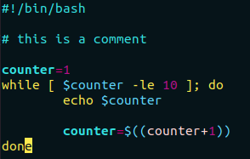


SHELL SCRIPTING - BASIC CONCEPTS #3
LINUX OS
Conditionals and loops:
The ‘while’ loop is used to repeat a set of commands while a condition is true.
Command-line arguments:
Command-line arguments are used to pass parameters to a script. They are accessed using the variables $1, $2, $3, and so on. For example:

Slide 36
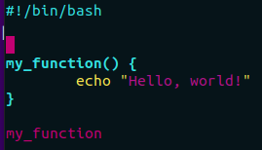

advanced scripting techniques and tools
LINUX OS
Functions
functions allow you to write reusable code blocks within a script, making your scripts more modular and easier to read and maintain.
basic syntax for defining and calling a function in a shell script:

Slide 37
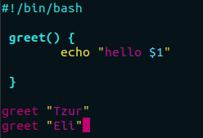
advanced scripting techniques and tools
LINUX OS
Passing parameters:
In this example, we define a function called greet that takes one parameter and echoes a personalized greeting. We call the function twice, passing in different names each time.

Slide 38
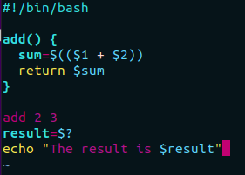
advanced scripting techniques and tools
LINUX OS
Returning values:
In this example, we define a function called add that takes two parameters and returns their sum. We call the function with the arguments 2 and 3, and store the return value in a variable called result. We then echo the result to the console.

Slide 39
Conclusion
LINUX OS
Throughout this lesson, we've covered the basics of shell scripting and learned how to use the Vim editor to write scripts. We explored how shell scripts can automate repetitive tasks in Linux, which is an essential skill for DevOps engineers.
We discussed the structure of a shell script, including the shebang line, comments, variables, and commands. We also learned how to use conditionals and loops to control the flow of a script and how to pass parameters to a script using command-line arguments.
Finally, we covered functions, which allow us to write reusable code blocks within a script. We saw how to define and call functions, pass parameters to them, and return values from them.
By mastering these skills, you'll be well-equipped to tackle a wide range of DevOps tasks, from automating deployments to monitoring system performance. I encourage you to practice these techniques and continue to explore the power of shell scripting as you progress in your DevOps journey.

Slide 40

Shell Scripting Exercises
LINUX OS
Task number 1:
Link to the Task: File management and searching script
Task number 2:
Link to the Task:
old files script
Task number 3:
Link to the task:
Automated daily backups
Good luck!

Slide 41

THANKS!
LINUX OS

